Slide 1
Stream Processing Platforms
Pravin Y Pawar

Slide 2



(Big Data) Analytics
Nothing New!
Has origins in end of last century!
Many cases failed to come out of labs
Constrained because of hardware and data requirements
In first decade of this century
it changed because of Google’s MapReduce paper (2004)
Next few years, whole ecosystem developed around Hadoop!
HDFS, MapReduce, Hive, Pig, Hbase, Sqoop, Oozie etc.
Mostly used for general purpose data processing and batch processing
In next decade
It become more faster with rise of Spark – in memory processing
But still processing requires time!
cyfe

Slide 3

Value of some data erodes with time!
Emerges need for real time data processing
Some use cases requires immediate attention and action
Real time traffic management
Stock markets / Financial markets
Surveillance
Production / Assembly lines
Patient care / monitoring
Because value of insights degrades very rapidly!
Need technology solutions that generates fast responses
Static queries with fast outputs – alerts, real time controlling
Adhoc queries on fast data – quickly analyse impact of latest events
Dynamic queries – multiple queries on same or different data's
Need for Speed – Offical EA site

Slide 4
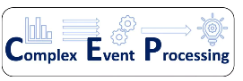




History
Real time Analytics transformed a lot
(Complex) Event Processing (1990+)
Active databases (2000+)
Distributed Streaming Operators
(Academics topic 2000+)
(Distributed) Stream Processing
Storm, 2011
Flink 2011
Samza 2013
Spark Streaming, 2014
Streaming SQL
KSQLDB, 2015+
Siddhi
Streaming Machine Learning

Slide 5
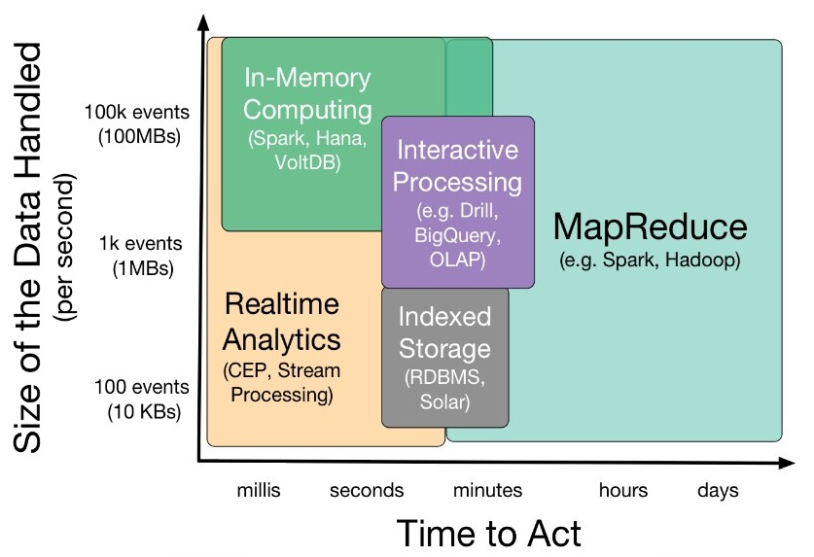
Data Analytics Landscape
Slide source :(WSO2)

Slide 6

Stream Processing Platforms
Stream Processing Patterns
Criteria for platform selection
Categorization of platforms
Template.net

Slide 7

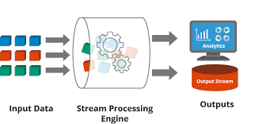
Real Time Analytics
Two flavours!
Real-time Interactive/Ad-hoc Analytics
users issue ad-hoc dynamic queries and the system responds interactively
data is indexed and made readily available when required
tools used are Druid, SAP Hana, VoltDB, MemSQL, and Apache Drill
Real-time Streaming Analytics / Stream Processing
process data as its coming
users issue static queries once - do not change
triggered when the condition is met
the system process data as they come in without storing
supported by technologies like
Stream processing (Storm, Samza, Flink)
Complex Event processing(Esper, WSO2)
Micro Batches (Spark Streaming)
codechampion
hazelcast

Slide 8

Stream Processing Patterns
Basic Patterns
Pattern 1 : Pre-processing ( Filter , transform, enrich, project …)
Pattern 2 : Alerts and Thresholds
Pattern 3 : Simple Counting and Counting with Windows
Pattern 4 : Joining event streams
Pattern 5 : Data Correlation, Missing Events and Erroneous data
xylos

Slide 9

Stream Processing Patterns(2)
Trend Handling Patterns
Pattern 7: Detecting Temporal Event Sequence Patterns
Pattern 8: Tracking (over space and time)
Pattern 9: Detecting Trends (rise, fall, ripple, turn...)
CommBox

Slide 10
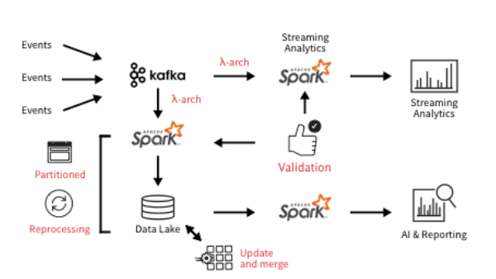
Stream Processing Patterns(3)
Mixed Patterns
Pattern 9: Interacting with Databases
Pattern 10: Running the same Query in Batch and Real-time Pipelines
Pattern 11: Detecting and switching to Detailed Analysis
Pattern 12: Using a machine learning model
databricks

Slide 11
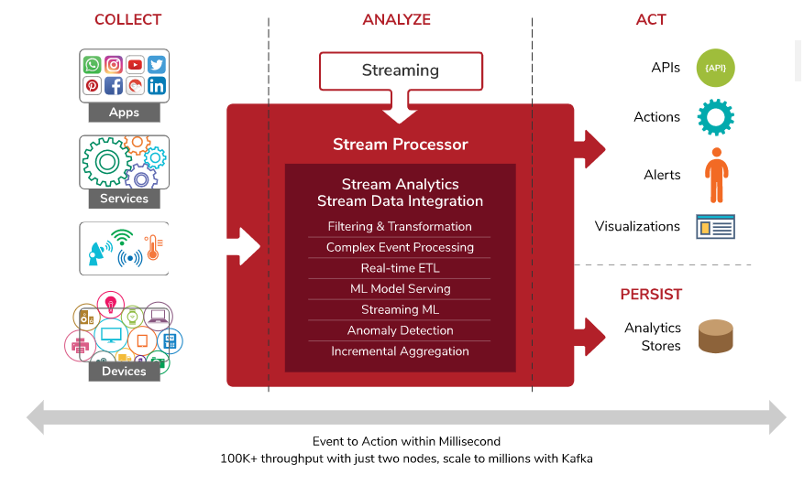
Stream Processors
Stream Processor
Software platforms that enable users to respond to incoming data streams faster
Streaming applications which run on stream processors come in many forms
Some examples:
Detect a condition and generate an alert
e.g., track the temperature of a kitchen appliance and create an alert if it exceeds a pre-defined threshold
Calculate a running average location of a moving object and update a web page
e.g., detect the location of a person and plot his trajectory on a map
Detect anomalies and act on them
e.g., detect a suspicious user and carry out a detailed analysis of his actions
WSO2

Slide 12
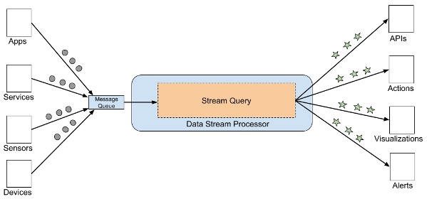
Reference Architecture for Streaming Applications
Needs three things
Data streams
A processor to process the data
Code to do something with the decisions
WSO2

Slide 13

How to select a stream processor?
There are many stream processors available to choose from.
The choice depends on the use case
and you should choose a stream processor that best matches your use case
Approach in two steps
First discuss key features required by most streaming applications
Then list optional features that can be selected based on the use case
Robert Half

Slide 14

How to select a stream processor? (2)
Must-Have Features : Support for Data Ingestion with a Message Broker
Very first question to be faced
“How does app receive data from external sources?”
Answer is to use a message broker and make sure stream processor can do this
Most of them do!
Some of the advantages of using a broker:
Messages are stored persistently right away
The broker would become your HA endpoint
If something goes wrong, can go back and replay the messages from the message broker
Scalable message brokers such as Kafka already handle the complexities of scalability

Slide 15

How to select a stream processor? (3)
Must-Have Features : Streaming SQL
The first generation of streaming engines such as Apache Storm and Apache Spark
Requires users to write code using programming language
Places the app code inside an agent in engine
The streaming engine lets users wire these agents together and ingest events
Leads to duplicated code at multiple places which leads to increased maintenance cost
Batch processing has already moved away from writing code and instead supports querying them via SQL
Can do the same with streaming analytics with query language - Streaming SQL.
Advantages of a streaming SQL language:
Easy to follow and easy to hire many developers who already know SQL
Expressive, short, sweet and fast
Defines core operations that cover 90% of problems
Can implement application specific custom analytics when they like by writing extensions
A query engine can better optimize the executions with a streaming SQL model

Slide 16
How to select a stream processor? (4)
Must-Have Features : Stream Processing APIs & Query Writing Environment
What tools should stream processor provide you with to develop streaming app?
Editor
to author queries, either visually or textually
supports visual error messages and auto-completion
shows the output while writing queries is useful
The first level is to be able to attach an event archive to the editor, replay them and see the outputs having written a query
The second level is to have outputs change while changing the query
Application debugger
Depth of debugging support varies
Some debuggers allows to put breakpoints and inspect the intermediate variable values and trace
Others provide event logs
Some debuggers provide visibility into metrics such as event flow count between operators
Drag and drop type Graphical User Interfaces (GUIs) ?
provide a toolbox containing the elements that can be dropped and a two-way scrollable canvas to drop the elements
contain icons for defining streams, operators such as windows, join, and filter
can modify the properties of each stream/operator by using the operators’ settings wizard
not clear whether drag and drop interface is better for building apps
with SQL, such an interface has never been used widely

Slide 17
How to select a stream processor? (5)
Must-Have Features : Reliability, High Availability (HA)
What happens if your system suddenly crashes?
If application is a stateful application, it will eventually lose valuable information (e.g., state) due to system failures
Ability to recover from failure as “reliability,”
Ability to continue operations with minimal interruption as High Availability (HA)
State Management
Most streaming queries are stateful
The state is the information the stream processor remembers between processing two events
Three types: Application state, User state, and System state
Application state
refers to the values being created and maintained while running the application
resides in the ephemeral store , such as the main memory and periodically gets flushed to the permanent store
User state is the user data which is accessed by the application to make runtime decisions
a permanent store such as an RDBMS can contain information of user’s credit history.
System state refers to everything else the framework provides to make sure that if the stream processor crashes, it is recoverable back to its normal operations.

Slide 18

How to select a stream processor? (6)
Optional Features
Business user friendliness via drag and drop type Graphical User Interfaces (GUIs)
Streaming Machine Learning
Optional Reliability Features
Message processing guarantee
Out-of-order events
Large Scale System Performance
Scalability
Handle large windows
123rf

Slide 19
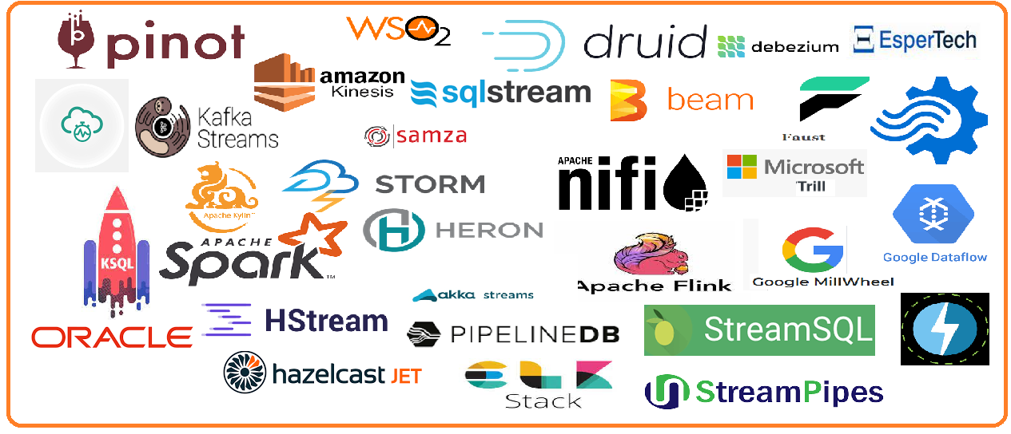
Landscape of Streaming Platforms

Slide 20

Categorization of Tools / Platforms
Lets Simplify!
Data Pipelines Tools
DataFlow / Transport / ETL tools
Conventional Queuing brokers
PubSub systems
Commercial solutions
Stream Processing
Engines
Libraries
DSL
Cloud services
Streaming Analytics
OLAP
Streaming SQL
Machine Learning
Purpose Built Tools
CEP
IoT
CDC
Logs

Slide 21










Categorization of Tools / Platforms(2)
Data Pipelines Tools
DataFlow / Transport / Transformation
Transformation
Apache Flume
Apache StreamSets
Apache NiFi
PubSub systems
Apache Kafka
Apache Pulsar
Google Cloud Pub-Sub
Commercial solutions
IBM MQ (Websphere MQ)
RabitMQ
Upsolver
Tibco Enterprise Message Service

Slide 22
Categorization of Tools / Platforms(3)
Stream Processing
Streaming Engines
Open Source
Apache Storm
Apache Heron
Apache Flink
Spark Streaming
Apache Samza
Apache Apex
Closed Source
Microsoft Trill
Google Millwheel
Libraries
Java
Kafka streams
StreamLine
Python
Faust
StreamAlert
StreamZ
Tributary
Scala
Akka Streams
FS2
Go
Benthos
Domain Specific Lang
Apache Beam
Cloud Services
AWS Kinesis
Google DataFlow
Azure Streaming Analytics
IBM Streaming Analytics
Oracle Cloud Infrastructure Streaming

Slide 23














Categorization of Tools / Platforms(4)
Streaming Analytics
Real-time OLAP
Apache Druid
Apache Pinot
Apache Kylin
AnalyticsDB (Alibaba Cloud)
Streaming SQL
KSqlDB
Imply.io
Materialize.io
Rockset
pipelinedb
StreamCQL
HStreamDB
SQLStream
Siddhi
Machine Learning
Apache Datasketches
Crème
Amazon Sagemaker

Slide 24










Categorization of Tools / Platforms(5)
Purpose Built
Complex Event Processing (CEP)
Esper
Oracle CEP
WsO2 Siddhi
Apama
IoT
Apache StreamPipes
HStreamDB
Ekuiper
Change Data Capture (CDC)
Debezium
IBM Infosphere
Qlik Replicate (formerly Attunity Replicate)
Talend
Oracle GoldenGate
Apache StreamSets
Logs Processing
ELK (Elastic Stack)
Logstash
Splunk

Slide 25

References
Just a few!
brief-history-analytics
cep-vs-streaming-processing-vs-cep-engines-vs-streaming-analytic-engines
patterns-for-streaming-realtime-analytics
vendors-and-products-in-the-event-stream-processing-market
distributed-stream-processing-with-wso2-stream-processor
how-to-choose-stream-processor
what-is-a-streaming-database

Slide 26
Thank You!
In our next session:

